Slide 1
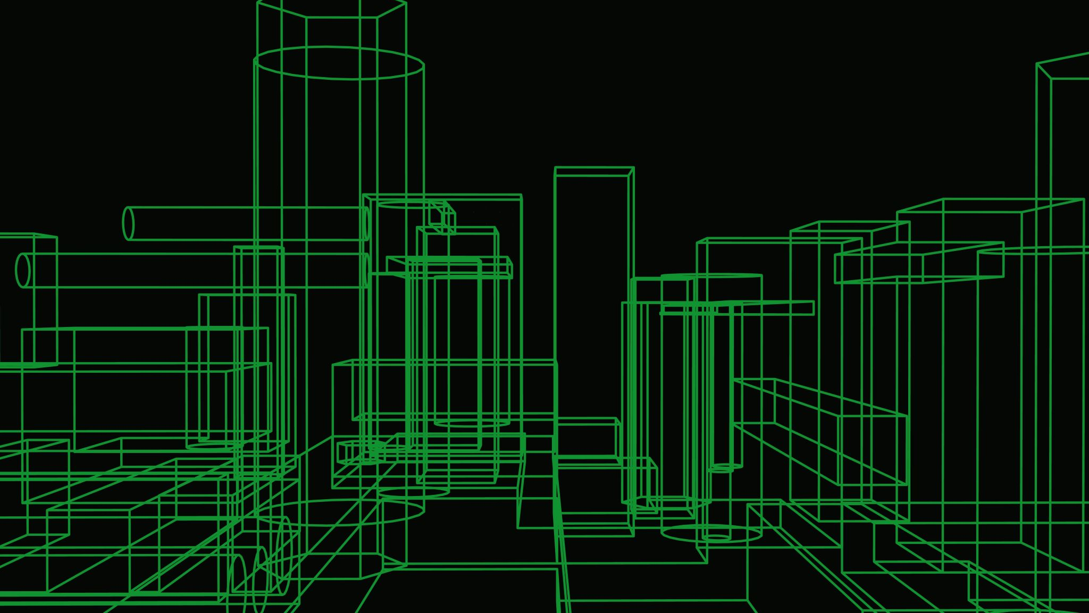
Smart home design
Group 7

Slide 2
Summary
3d models and schematics
Software
Expectations and conclusion

Slide 3
3d models and schematics
Kicad
Fusion 360
Everyone had their own part

Slide 4
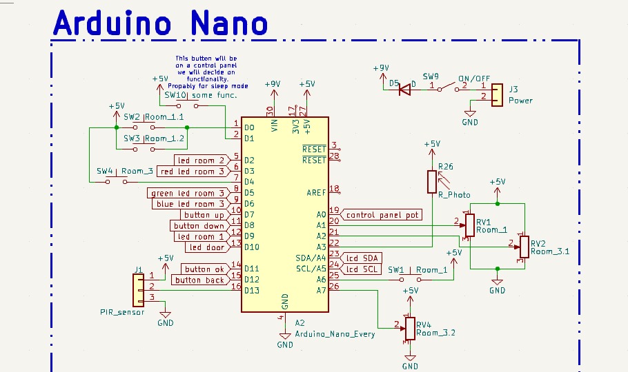

Slide 5
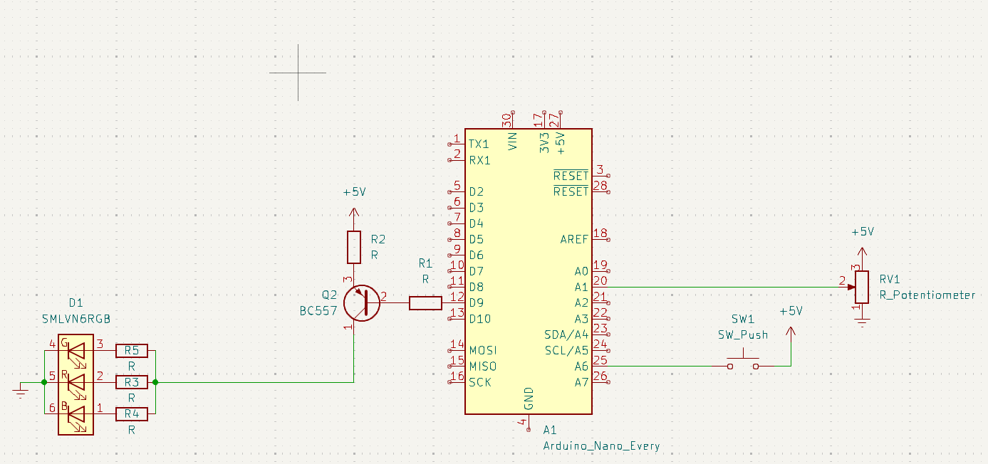

Slide 6
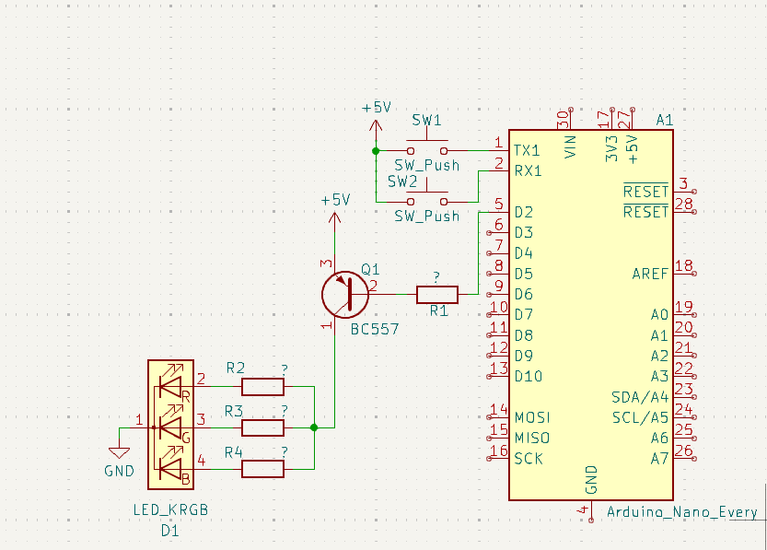

Slide 7
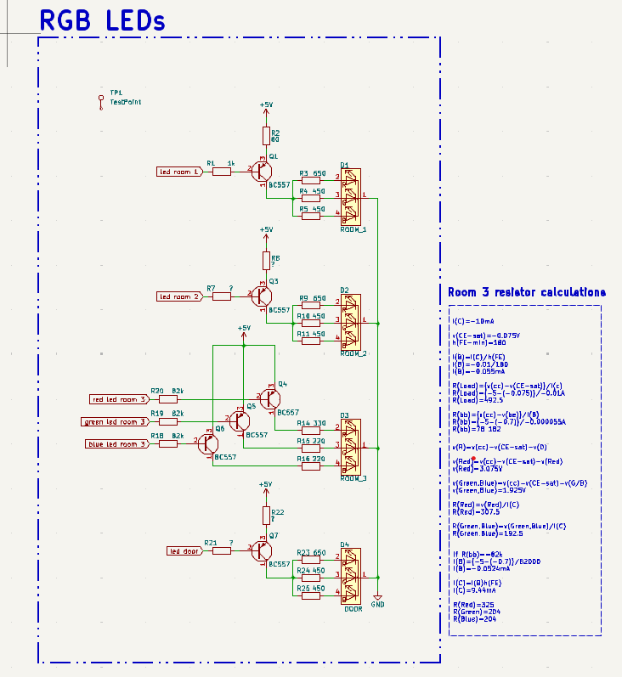

Slide 8
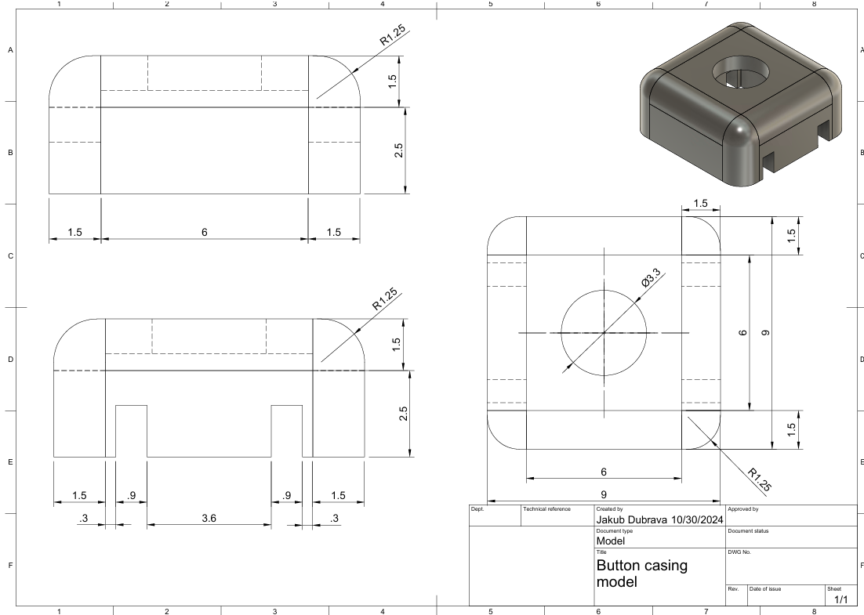

Slide 9
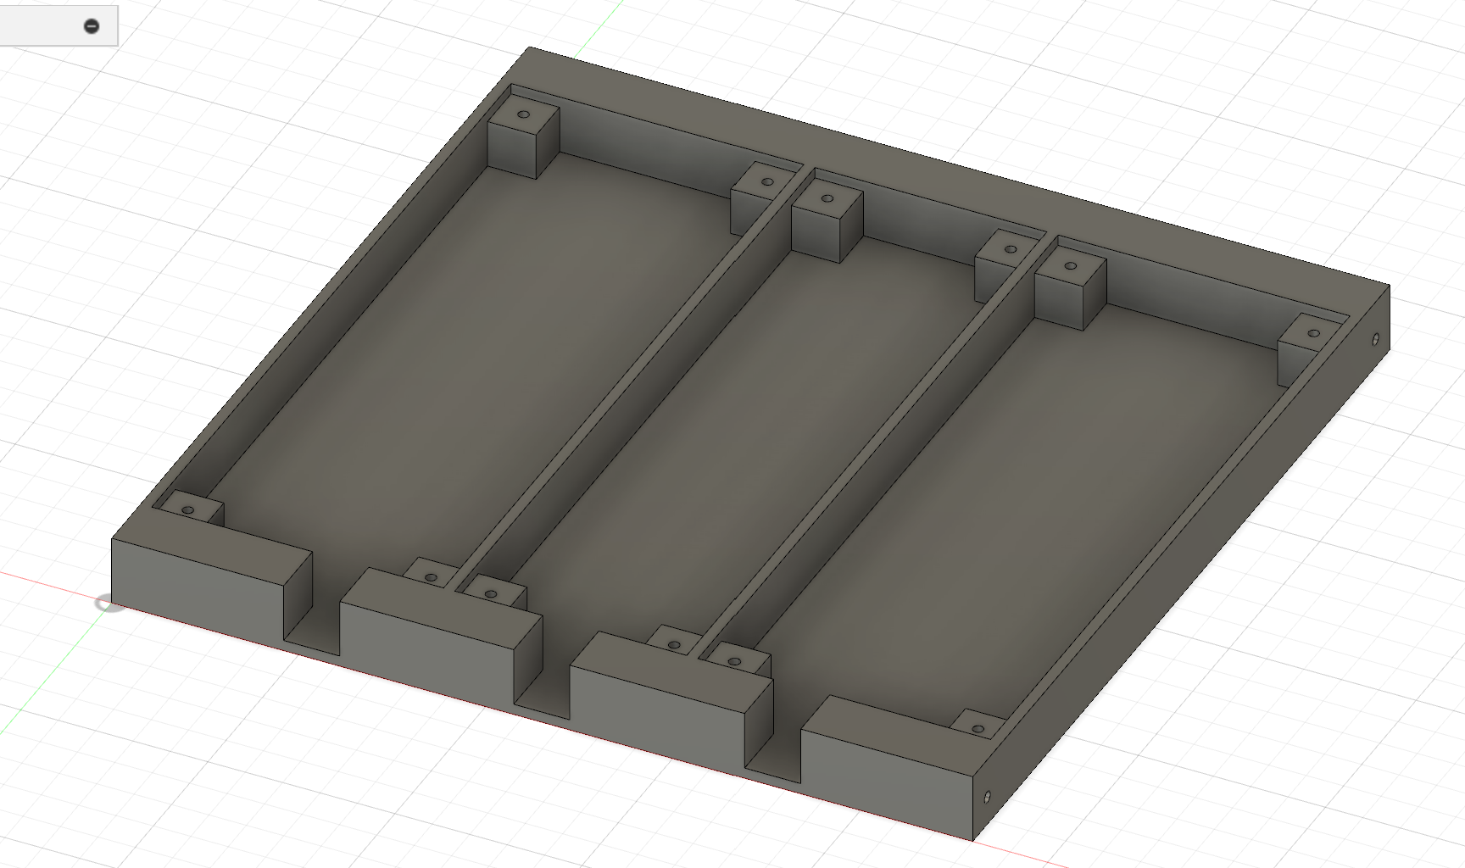

Slide 10
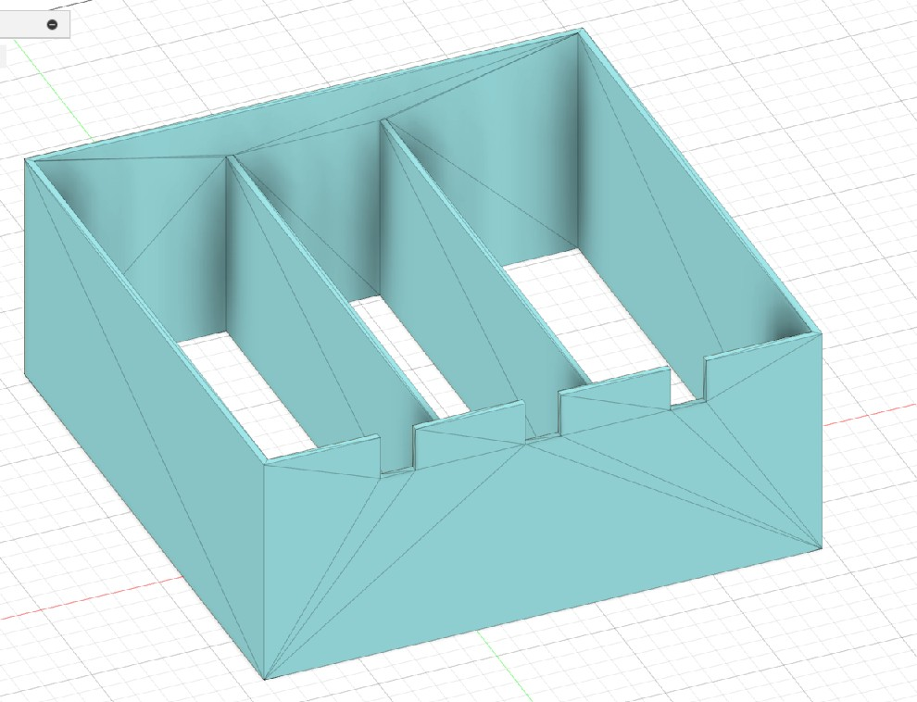

Slide 11
Software
Visual studio
C programming language

Slide 12
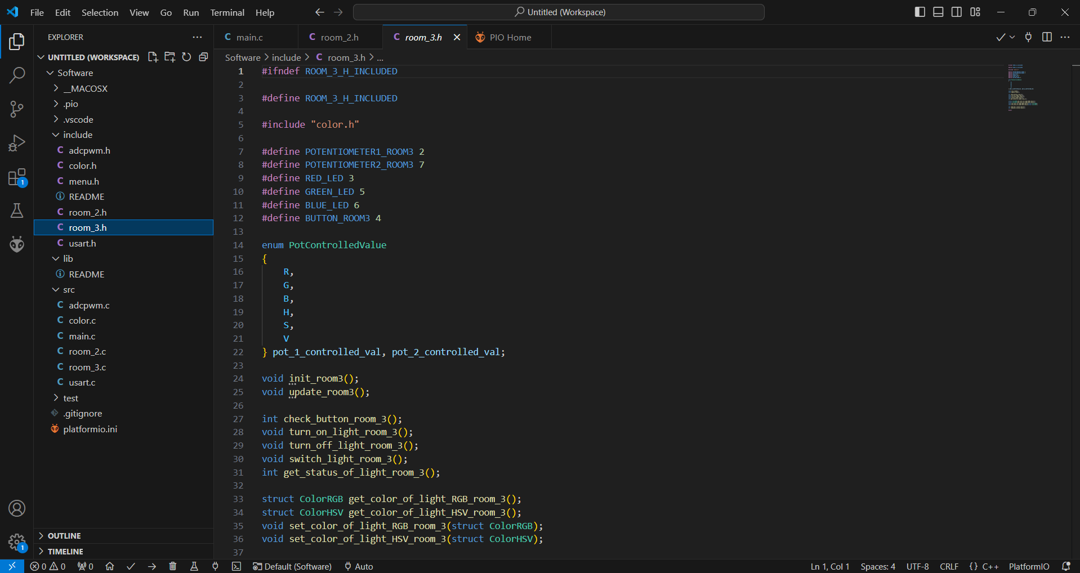

Slide 13
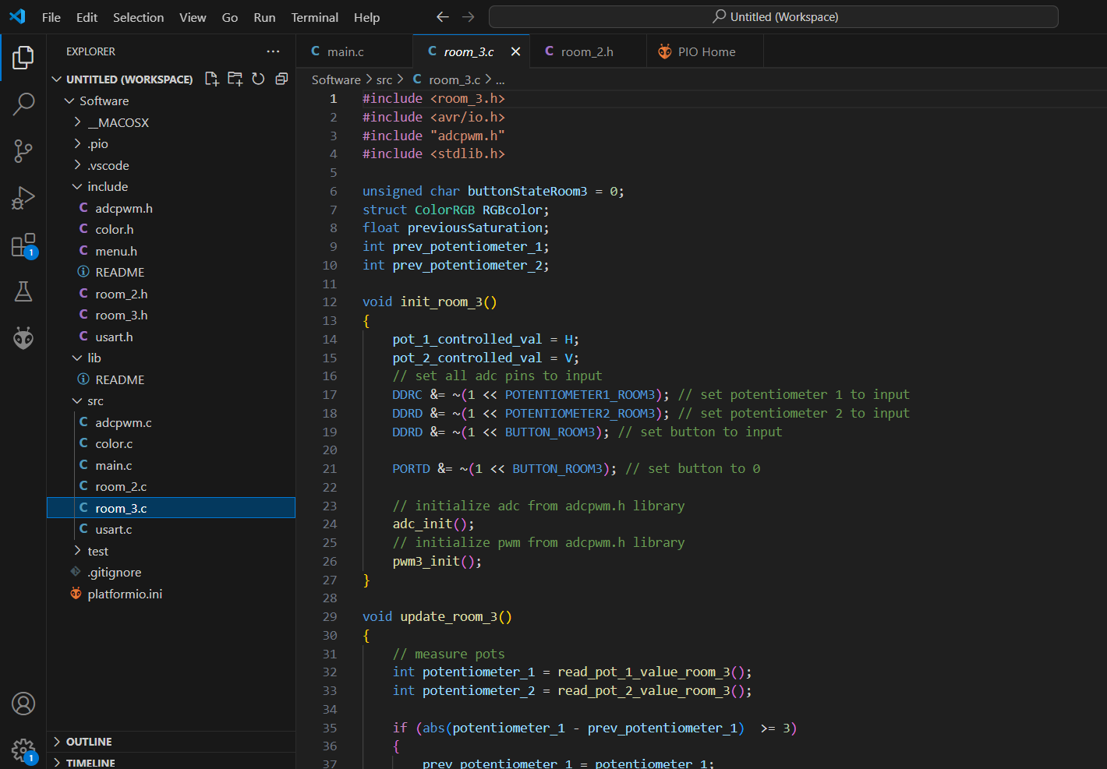

Slide 14
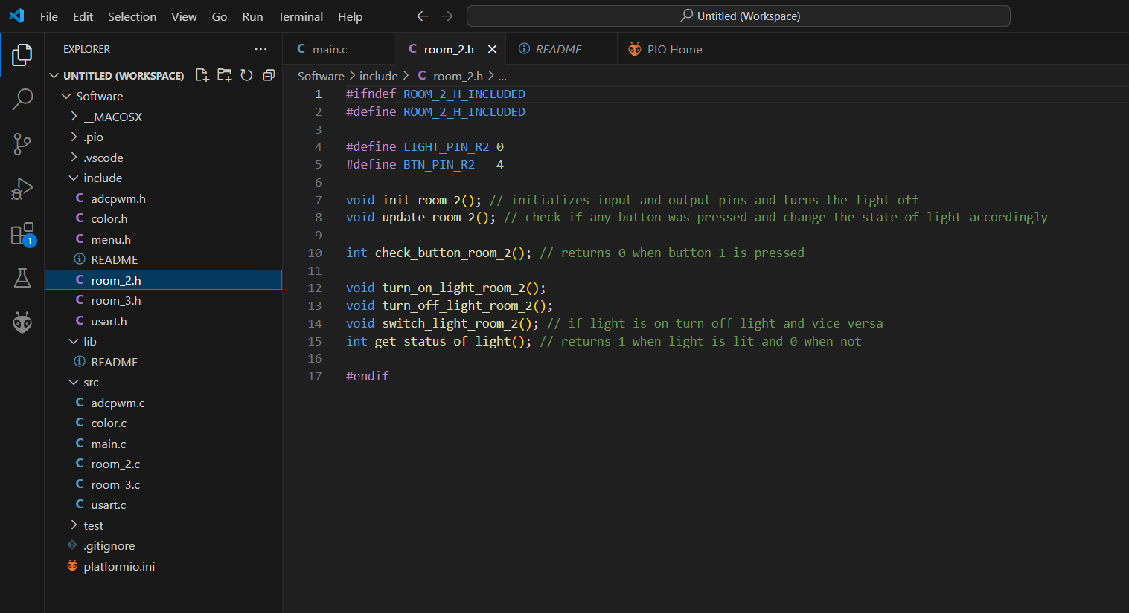

Slide 15
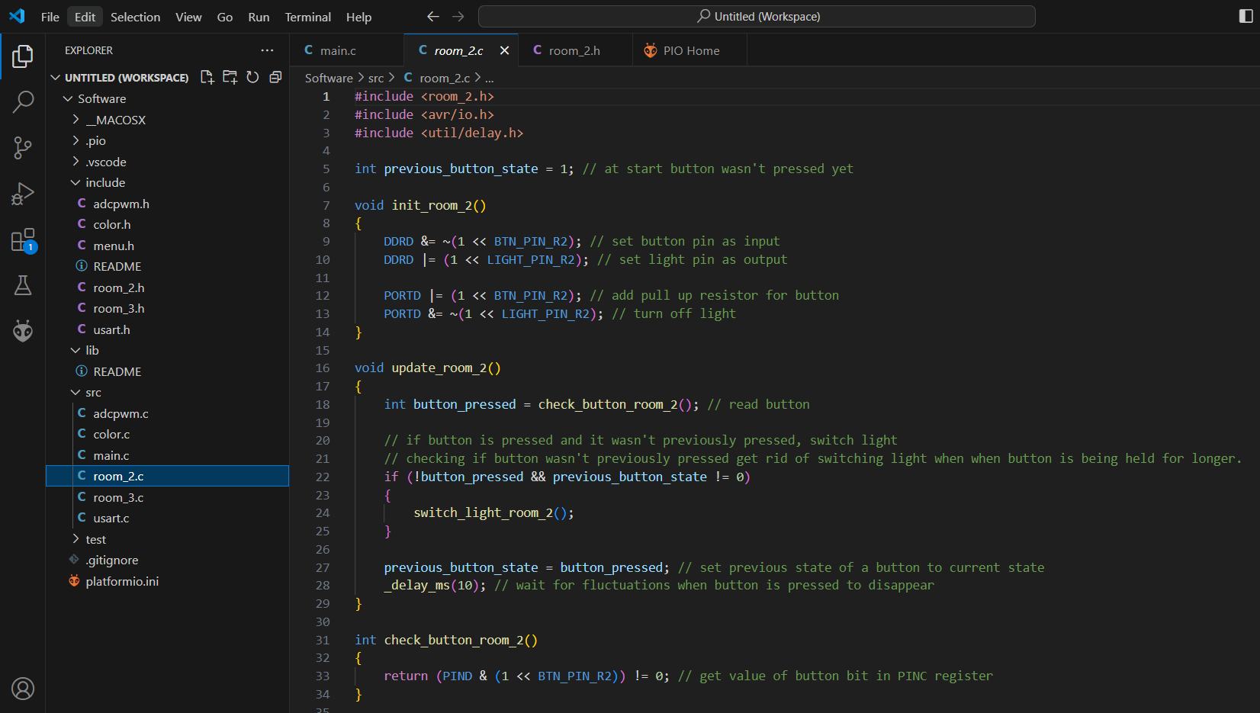

Slide 16
Expectations and conclusion
Fully functional before the given deadline
Light status can be changed from control panel
Outside light should turn on when detecting movement
Continuing work on software
Design of the casing for the main control panel
Debugging and fine tunning

